Slide 1
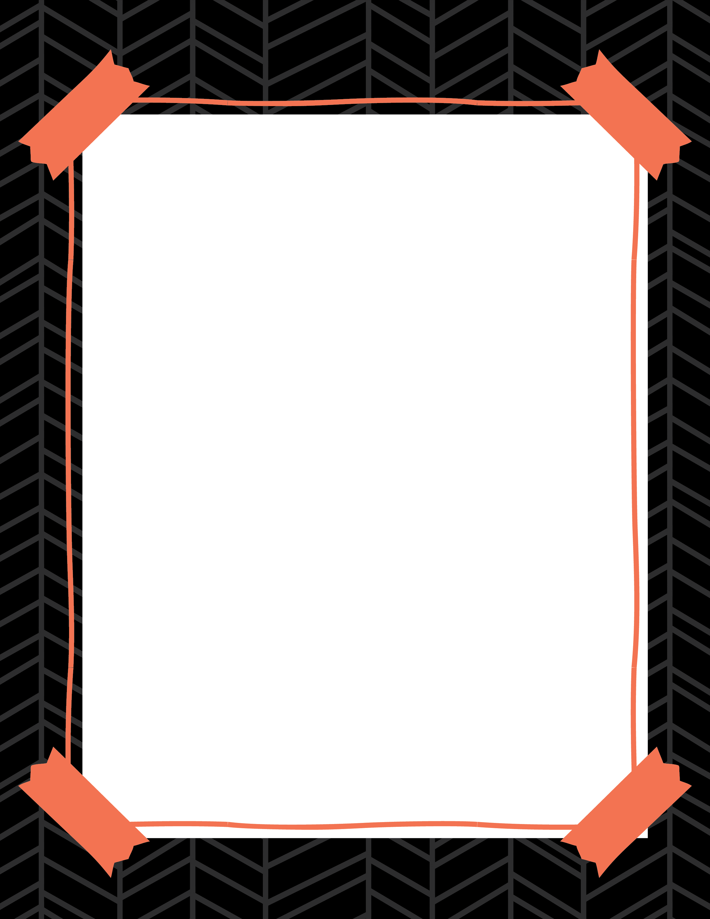
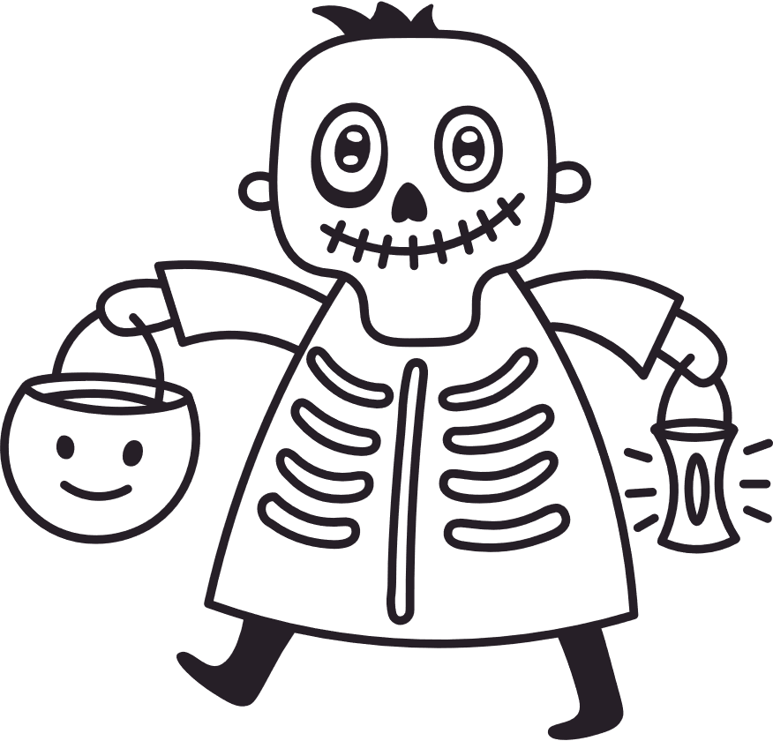
HAUNTED HALLOWEEN
WELCOME TO OUR
COSTUME PARTY
THANK YOU FOR JOINING US!

Slide 2








Cake Toppers / Stickers - For cake toppers, print and cut out circles, tape each one to a toothpick, and stick them on your cupcakes. For stickers, use Avery sheet template 2” round labels.

Slide 3


Table cards - Print and cut out these table cards then fold on the dotted line to use in your party.
ADD NAME
ADD NAME
ADD DESCRIPTION
ADD DESCRIPTION
ADD NAME
ADD NAME
ADD DESCRIPTION
ADD DESCRIPTION

Slide 4




Wall or Door Cut-out Decorations - Print and cut these out, then tape them to your door or wall.

Slide 5

Garland Page - Print and cut out the flags, punch a hole through the circle, thread a string through and hang across a wall or doorway.

Slide 6

Garland Page - Print and cut out the flags, punch a hole through the circle, thread a string through and hang across a wall or doorway.

